Slide 1
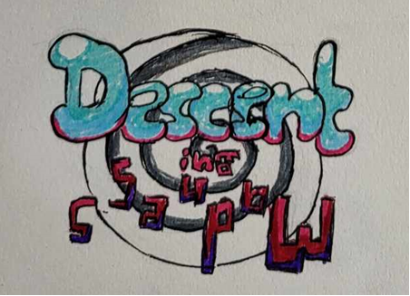
Obstacle Course Game Concept
Daniel Foth

Slide 2
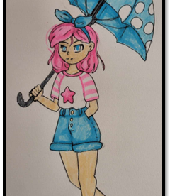
Overview
Descent into Madness is an Alice in Wonderland inspired game where the player descends the rabbit hole.
The game is an Endless Platformer where the further the player gets the faster and crazier the game gets.
The player's goal is to score the highest score they can before they run out of health.

Slide 3
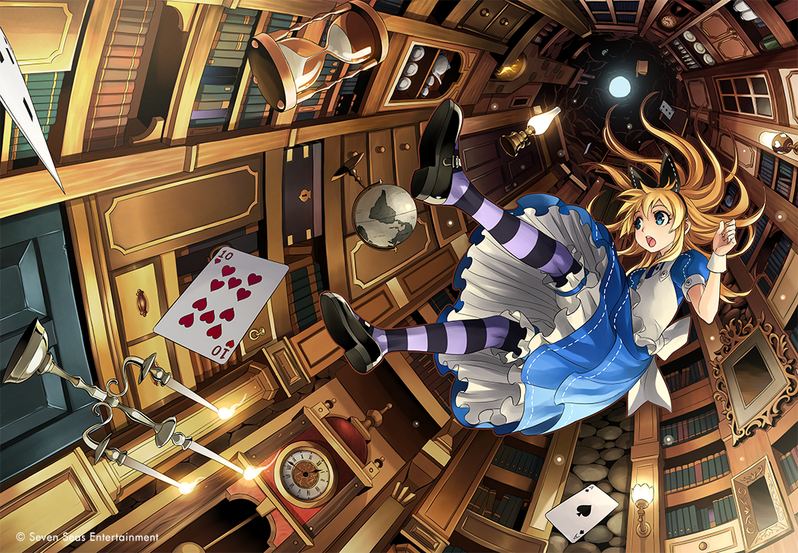
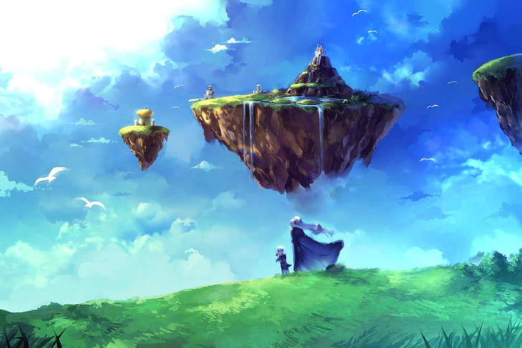
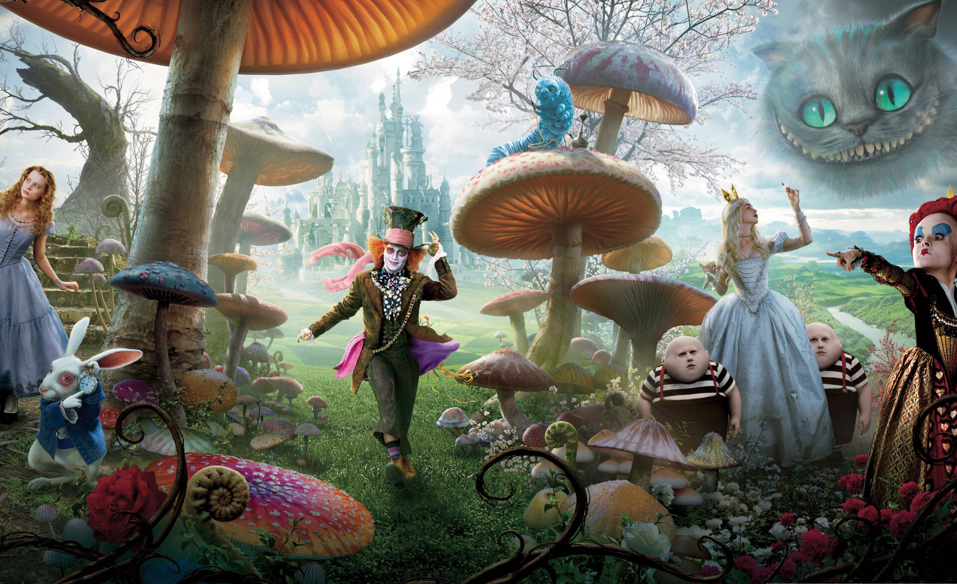
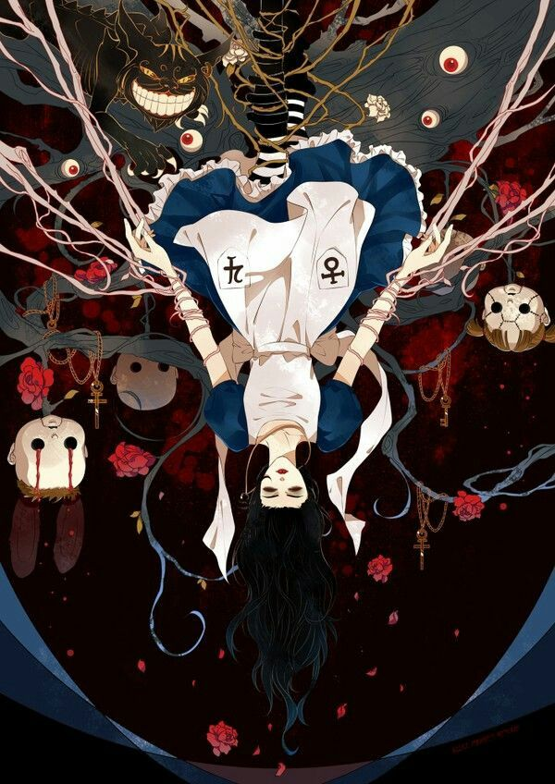
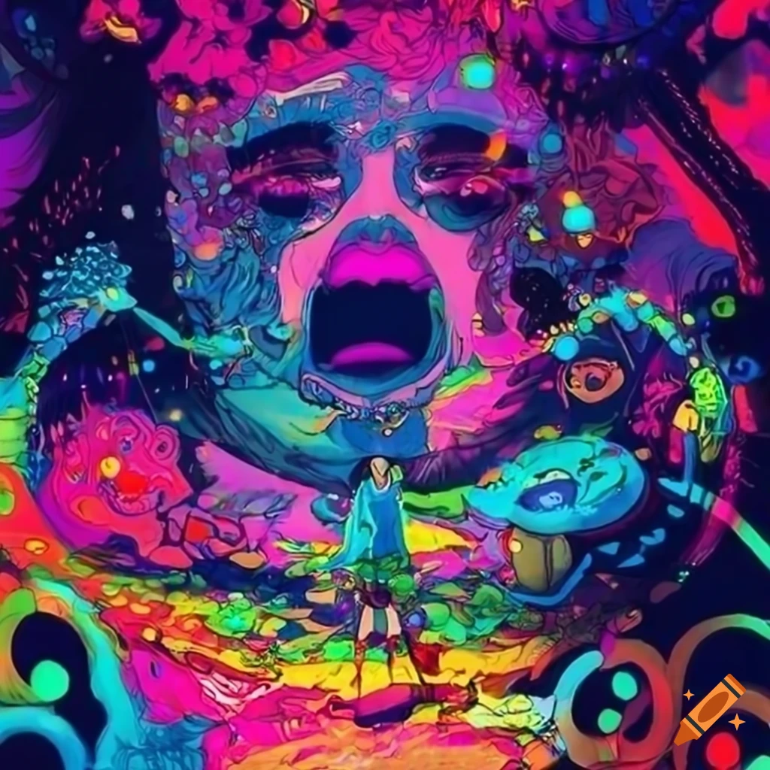
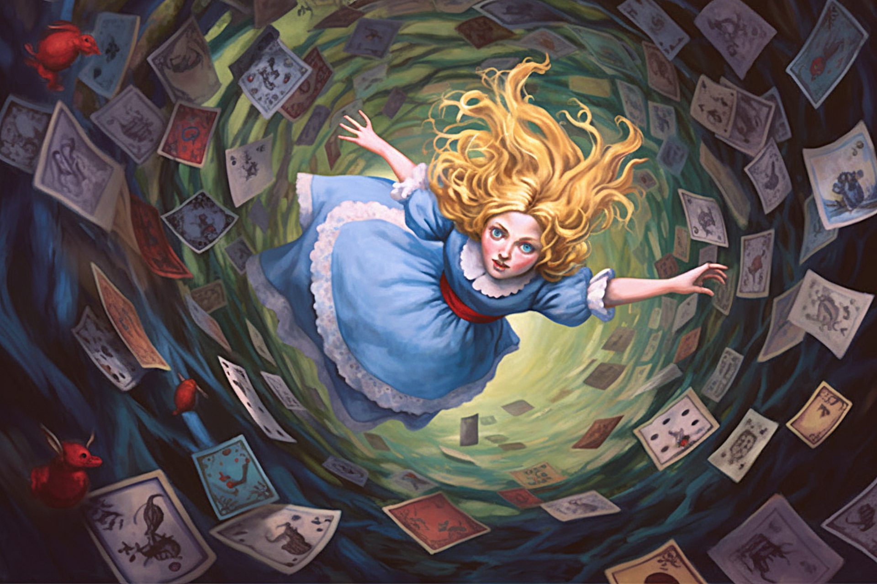
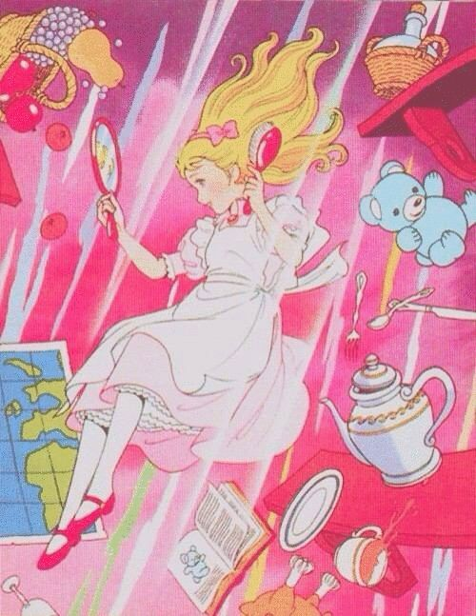


Mood board

Slide 4

Game Mechanics
Gliding – using an umbrella to slow fall speed, limited durability
Fall Damage - takes damage when landing from falling to fast
Endless Platforming – more platforms spawn as the player goes down, and the game loop speeds up

Slide 5
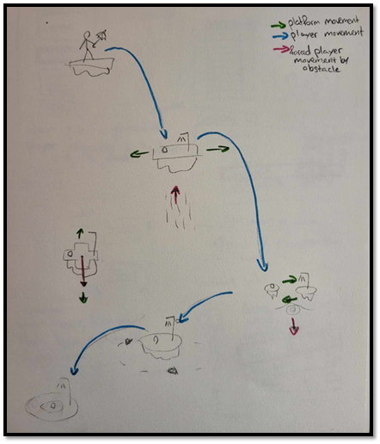
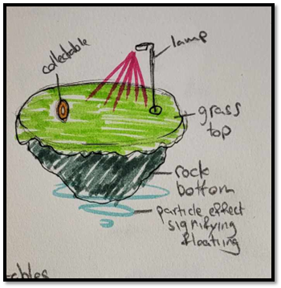
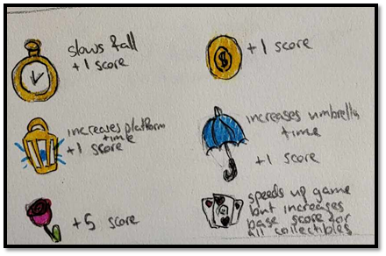
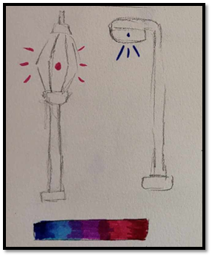
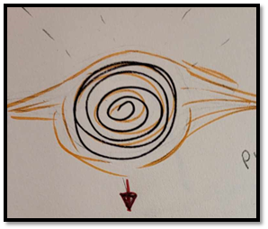
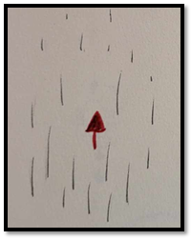
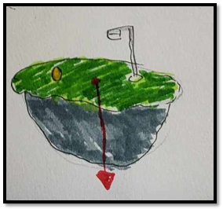
Level Design

Slide 6
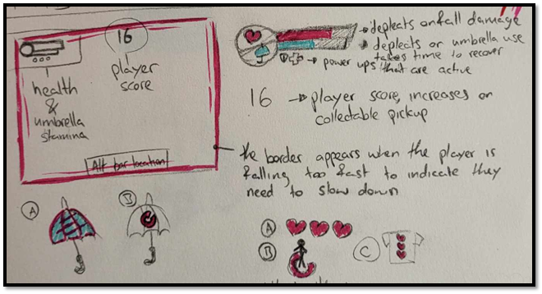
HUD
Health
Umbrella Durability
Score
Boarder - indicates falling too fast

Slide 7
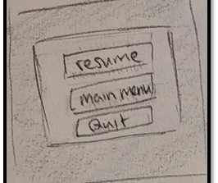
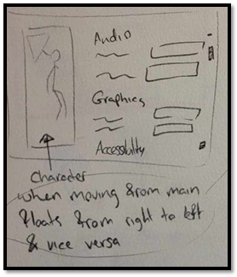
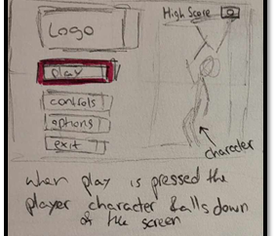
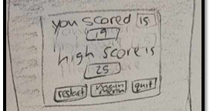
Menus
Main Menu
Options
Controls
Pause
Game Over

Slide 8
Asset Development Plan
Interfaces - Interfaces will be made in UE5, any visual assets needed will be made in Krita.
3D Models - All 3D models will be made & textured in blender and imported into UE5.
Audio - All audio assets will be sourced with a Creative Commons license from https://freesound.org/.
Audacity and Krita will be used for editing sounds and images.

Slide 9
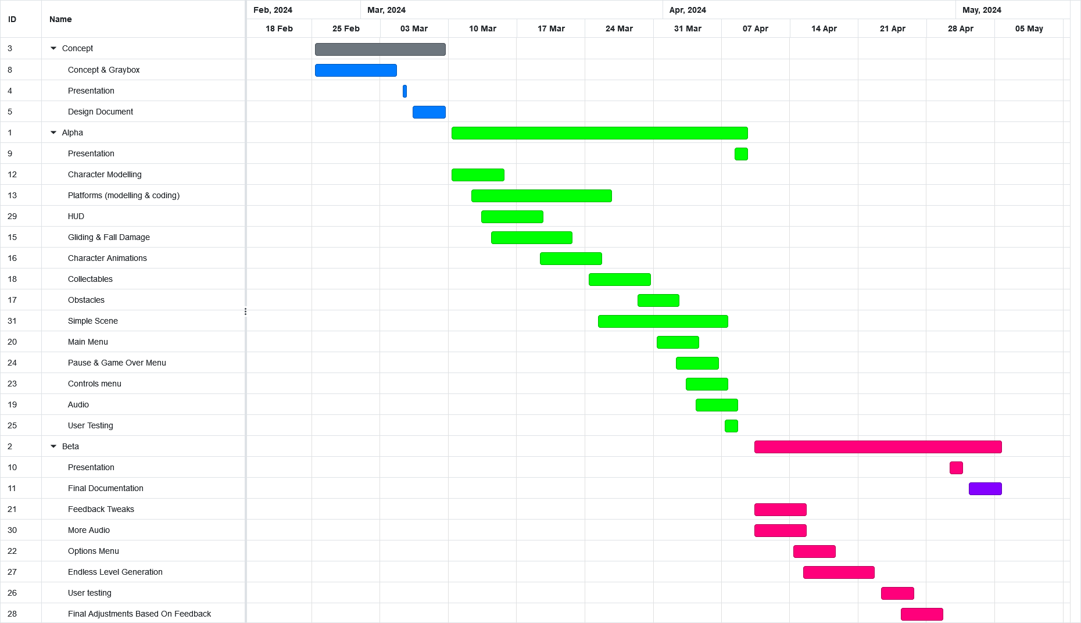
Roadmap

Slide 10
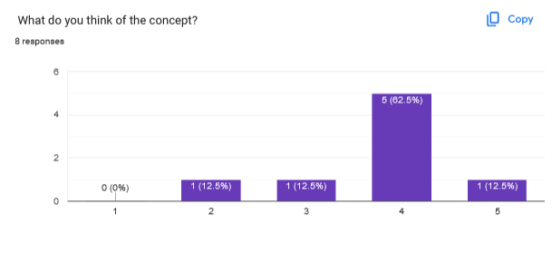
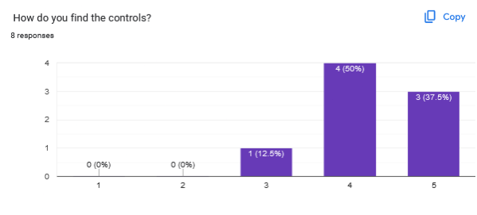
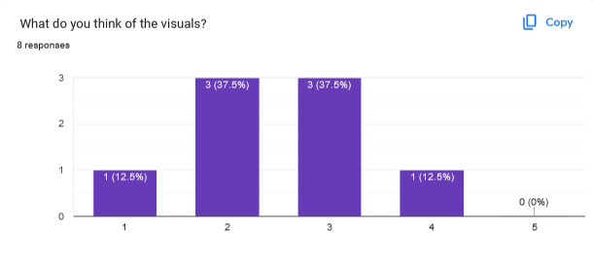
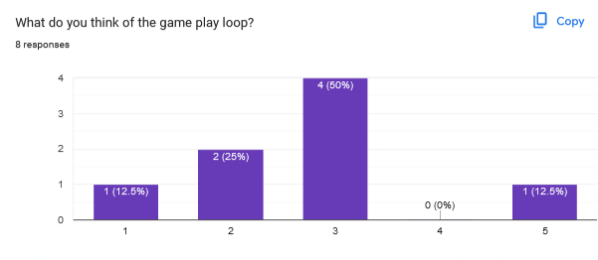
User Testing
The concept was well received
The gray box didn't have a well-defined goal but concept has a very well-defined goal.
The gliding mechanic in gray box had some issues, but generally the controls felt solid. Simple and easy to understand controls preferred.
The gray box is also too simple and repetitive for some. Addressed with a variety of platforms, collectables and obstacles.
Key Feedback to work on for alpha:
clearer goal needs to be established
platforms further apart so you need to use the umbrella mechanic
The circles (which I'm assuming are pickups) are not working
bit too simple, needs to be fleshed out a bit more
visuals should evoke more feelings of madness
Could use more wonderland associated imagery, in-game visuals are barebones

Slide 11
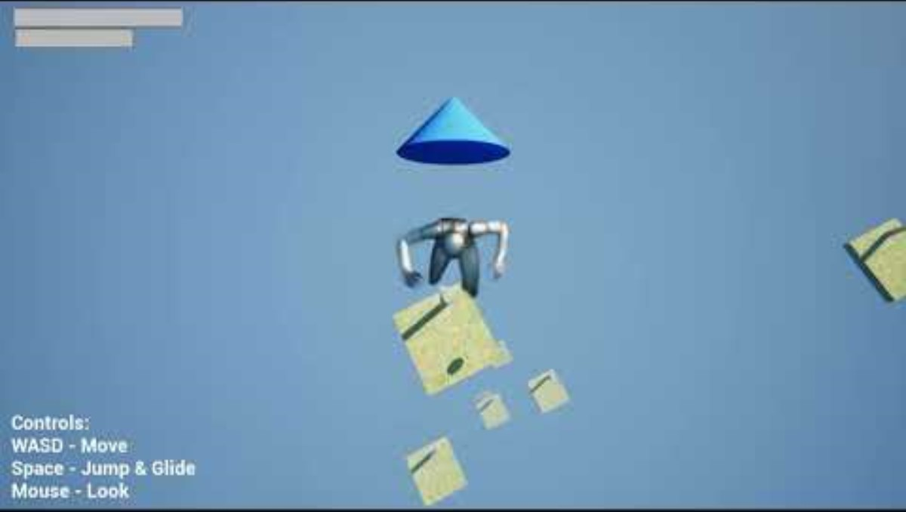
Gray Box Demo

Slide 12

Questions?

